Slide 1
How to write an essay
Centre for Learner Success

Slide 2
What is an essay?
Writing an essay
An essay is a written response to a particular question and outlines the author’s position on the issue in question
Position - Where the author stands on the issue

Slide 3
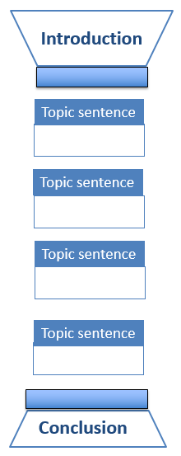
Essay structure
Set up context for your topic
Significance of broad topic
Focus in the essay
Main idea/argument (thesis statement)
10%
Body paragraphs support main argument
One main idea per paragraph
– expressed in topic sentence
Support main idea with evidence from literature – explanations, reasons etc.
Lead reader through argument - Connect sentences and paragraphs
Anchor each paragraph to Introduction by repeating key words in topic sentences
Come to logical conclusion
Summarise main ideas
Implications of what you’ve found
10%

Slide 4

Writing your essay
What are the steps involved?
Analyse question
Brainstorm topic
Research
Formulate thesis statement
Create outline
Write first draft
Revise and proofread

Slide 5

Analyse the question: TTF Method
Topic, Task, Focus
What are the Topic words
- what is the broad topic?
What are the Task words?
- Define? Analyse? Examine?
What is the Focus (Restrictions)?
- how is the topic narrowed
down?

Slide 6
Analyse the question: TTF Method (Continued)
Example question:
Write a 1000-word essay on the definition of ‘female work’ in the twentieth century
Topic words (broad topic)? – female work
Task word? - Define
Focus? – twentieth century

Slide 7
Task words
Practise question:
In order to prevent workplace bullying, organisations need to look beyond issues of individual personality and examine how underlying organisational factors can contribute to the problem. Discuss.
Topic words (broad topic)? – workplace bullying
Task word? – Discuss
Focus? - (contribution of) individual personality
and organisational factors

Slide 8
Analysing the question
Task word: Discuss
Following a statement or a quotation, this implies that a judgment about the statement or quotation is necessary:
Do you agree or disagree with the statement? Why?
Do you agree partially? Why?
Indicate agreement/disagreement/partial agreement in thesis statement
Come to a conclusion on the issue:
Does the evidence in the literature support the statement?

Slide 9
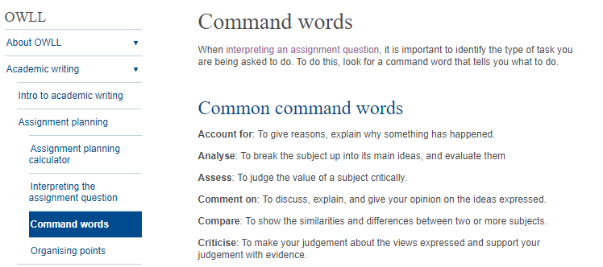
Analysing the question (Continued)
Task word: Discuss
In order to prevent workplace bullying, organisations need to look beyond issues of individual personality and examine how underlying organisational factors can contribute to the problem. Discuss.
Does the evidence in the literature (your readings) support this statement?

Slide 10
Brainstorm before library search
What are the key questions that need answering?
What is workplace bullying? Definition(s) Define your concepts
Why is it a problem? Explain significance of problem: Effect on individuals/ organisations/ society – evidence from literature
Contribution of individual personality? How? Why?
Contribution of organisational factors?
Which factors? Why? How? Do they work in combination?
Given our understanding of factors, how can workplace bullying be prevented? Examples of successful implementation of measures?
Key words/phrases for Library search

Slide 11
Keep key questions in front of you – you’re searching for relevant information
Key Questions | Article | My Notes
Definitions of workplace Bullying Significance of problem Organisational factors Preventative measures | Bentley et al. (2012)

Slide 12

Your voice guides the argument…
Writing the essay: Presenting an evidence-based argument
…a bit like a barrister in a legal case
Careful selection of relevant and reliable evidence to support your case – your argument
Presentation of your argument, using evidence to back up what you say
Introduce the issue → State your position → Defend your position

Slide 13

Formulating a thesis statement
In order to prevent workplace bullying, organisations need to look beyond issues of individual personality and examine how underlying organisational factors can contribute to the problem. Discuss.
Sample thesis statement:
Issues with individual employees cannot be ignored in any attempt to analyse and address an organisation’s problem with workplace bullying. However it is crucial that the organisation also recognises and addresses organisational factors including A, B, C, and D which may be enabling and even encouraging bullying behaviour.

Slide 14
Planning an outline
In order to prevent workplace bullying, organisations need to look beyond issues of individual personality and examine how underlying organisational factors can contribute to the problem. Discuss. 1,500 words
average words per paragraph = 150 - 200
So for this essay, start off with a rough plan for ... 10 or 11 paragraphs

Slide 15
A plan for this essay might look like this …
1: Introduction: prevalence of workplace bullying; definition of bullying;
consequences of bullying: individual & organisational
10-15% of words
Thesis statement
What is the issue?
Why is it a problem – how can it lead to/encourage bullying?
What interventions can be used address it?
2/3 : Factors with individual employees
4/5 : Organisational factor 1
6/7 : Organisational factor 2
8/9: Organisational factor 3
10: Conclusion: combination of interventions needed to address
complex problem; future – research and practice
10% of words

Slide 16




When do you refer to the literature?
1: Introduction: prevalence of workplace bullying; definition of bullying;
consequences of bullying: individual & organisational
Thesis statement
2/3 : Factors with individual employees
4/5 : Organisational factor 1
6/7 : Organisational factor 2
8/9: Organisational factor 3
10: Conclusion: combination of interventions needed to address
complex problem; future – research and practice

Slide 17

Getting feedback
Learning Consultants at your campus CTL
- appointment required
Writing Consultants (Library)
- walk-in consultations
Pre-reading service – three-day turnaround
Other students – honest opinions
Yourself – go back with fresh eyes
https://massey-nz.libcal.com/appointments?lid=3000

Slide 18
Revising the assignment
ADD
What additional information is needed?
SUBTRACT
What information seems unnecessary?
MOVE
What information could be moved elsewhere?
CHANGE
What information needs changing?

Slide 19
Proofreading and editing your work
Spelling
Commonly confused words: (there/their/they’re; its/it’s)
Grammar Conventions: (commas, apostrophes, verb tense…)
Paragraphing: one idea per paragraph
Referencing: in-text and references page

Slide 20
How to write an essay Summary
Analysis of the question
Research
Formulating the thesis statement
Creating an outline
Writing the first draft
Revising and proofreading

Slide 21
Need help?
Individual Support: Want to discuss your assignment before you hand it in? Want to discuss study skills (e.g. how to manage time)? Book an appointment at https://massey-nz.libcal.com/
Pre-Reading Service: Submit a draft assignment and receive individual written feedback on your assignment’s structure, focus, referencing, and use of sources. This service is available to first year internal and all distance students. You can access the forum through the Academic Writing and Learning Support site on your Stream homepage.
Workshops: Seminars and workshops are run on campus and online, which can help you with writing and study skills, such as essay writing, referencing, and writing research proposals. See here for programmes and registration details. See http://owll.massey.ac.nz/about-OWLL/workshops.php
Academic Q+A forum: Ask our consultants a question about academic writing and/or study skills. The Q & A forum is a place for students to receive help with quick, study-related questions. You can access the forum through the Academic Writing and Learning Support site on your Stream homepage.
OWLL: Information about academic writing and study skills, including assignment planning, essays, reports, and referencing. Go to http://owll.massey.ac.nz/index.php
Disability Services: A range of services and support for students who have health and disability issues that are impacting their study.
Pacific Massey: Whether studying as an internal or distance student, you can also access Learning support from the Pasifika Learning Advisors.
Te Rau Tauawhi: Ko tā Te Rau Tauawhi he āwhina i ngā tauira Māori ki te tuku aromatawatai ki Te Reo Māori, ki te tautoko hoki i ngā āhuatanga whakarite tuhinga. The Te Rau Tauawhi Māori Student Centre can help you to submit your assignment in Te Reo Māori and provide general assignment structure support.
https://massey-nz.libcal.com/

