Slide 1
How to Manage your Time
Time management skills

Slide 2

Learning Outcome
Apply timetabling & prioritising skills to get started with studying at university level

Slide 3
Five steps to better time management at university
Get a wall planner
Fill in a timetable
Write a “to do” list
Prioritise your tasks
Taking back control (when things go wrong)

Slide 4
How much time is needed for study?
10-12.5 hours per paper/week/semester (average for a single smester15 credit course)
Think of it as a full-time job
Workload planning tool : http://tur-www1.massey.ac.nz/~wwwodev/tools/distanceplanning/
See recommended workload.

Slide 5
Step 1: Get a Wall Planner
Write down when your exams are & when assignments are due

Slide 6
Step 2: Fill in a timetable

Slide 7
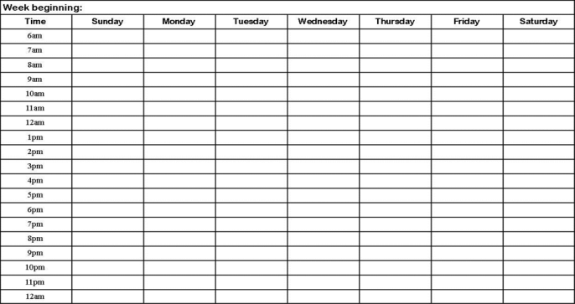
Step 2: Fill in a timetable

Slide 8
Step 2: Fill in a timetable
Block out your lecture times
Block out your tutorials
Block out existing commitments: anything you do on a regular basis
Block out your study time in the time you have left

Slide 9
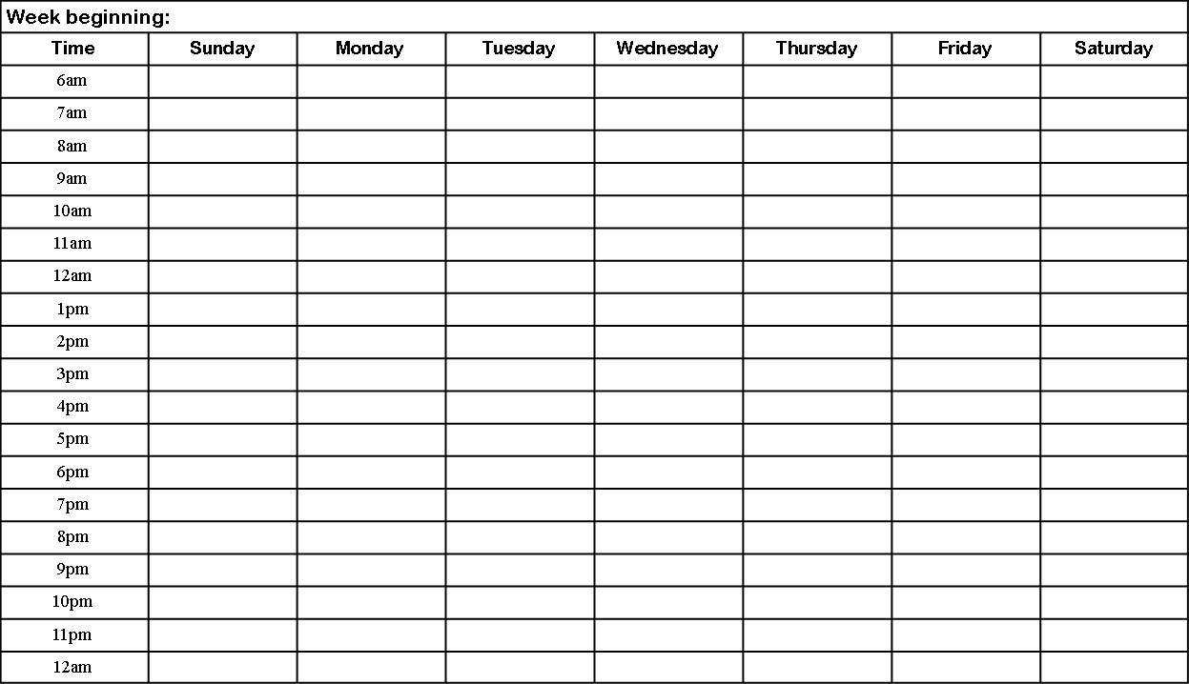
Example of a Study Timetable
Gym
Study
Study
Lecture
Tutorial
Study
Lecture
Study
Study
Gym
Lecture
Lecture
Paid work
Paid work
Study
Tutorial
Study
Study
Tutorial
Tutorial
Study
Tutorial
Study
Study
Study

Slide 10
What is good about this timetable?
Lecture
(115.111)
Study
Study
Study
Gym
Tutorial
Study
Lecture
(115.113)
Study
Study
Paid work
Lecture
(115.112)
Tutorial
Paid work
Study
Study
Gym
Study
Gym
Study
Study
Study
Study

Slide 11
Allows at least 12.5 hours of study per course Plenty of breaks Good work-life balance with exercise and time for leisure activities and paid work Flexibility
Lecture
(115.111)
Study
Study
Study
Gym
Tutorial
Study
Lecture
(115.113)
Study
Study
Paid work
Lecture
(115.112)
Tutorial
Paid work
Study
Study
Gym
Study
Gym
Study
Study
Study
Study

Slide 12
Two tips
Have breaks during your study (study for 50 minutes, 10-minute break)
Schedule study in your optimal time

Slide 13
Step 3: Write a ‘to do’ list
Check out Stream & your study guide
Go to lectures and tutorials & take notes
Read set readings & take notes
Do any online quizzes or activities
Do research for assignments
The assignment planning calculator is a useful tool

Slide 14
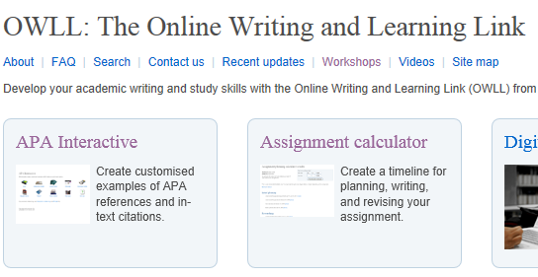

OWLL assignment planning calculator
http://owll.massey.ac.nz

Slide 15
OWLL assignment planning calculator
Initial planning
Researching
Writing
Reviewing & revising
Reviewing feedback

Slide 16
Day | Week : 6 – 10 March | Done
Mon | 175.733 : Read Chapter 3 (Issues in Health Promotion) 175.733 lecture 9:00 175.720 lecture 2:30
Tues | 175.720 : Read article on women’s rights Write reflection/reaction in journal
Wed | StudyUp online session: Avoiding plagiarism [12 pm]
Thurs | 175.743 : Read article on introduction to health psychology Write reflection/reaction in journal
Fri | Study for 175.720 quiz on Monday 175.711 tutorial 10:30
Sat/Sun | Revise notes for 175.733 (Chapter 3)
Plan your week & day

Slide 17
Step 4: Prioritise your tasks
How do you know how long something will take?
How do you decide what to do first?

Slide 18
How long will tasks take?
Consider the length of an assignment or reading
Sometimes you don’t know so use the time and a half rule

Slide 19
Which to do first?
Look at your wall planner, timetable or to do list & ask yourself is it a task I need to do now or something less urgent?
Prioritise time sensitive tasks e.g., readings before lectures, assignments due soon
Sometimes it doesn’t matter what you do first. Just get on with it!

Slide 20
Step 5:
Taking back control
Sometimes we make poor choices & things go wrong
Sometimes life happens & things go wrong

Slide 21
Avoid procrastination & distractions
Break tasks into small, manageable tasks
Turn off automatic notifications & alerts
Make checking social media a reward
Remind yourself of your end goals (long & short term)
Follow the DIN approach: Do It Now!

Slide 22
Life getting in the way
Is there available time in the evenings or mornings? Can you get up earlier or stay up later?
Are there existing commitments you can put on hold?
If you have kids, can someone babysit? Ask for help!
Set study time & stick to it: No distractions!

Slide 23
Summary
Get a wall planner
Fill in a timetable
Write a to do list
Prioritise your tasks
Take back control if things go wrong

Slide 24
Need help?
We have a range of free services to help with study
learnersuccess@massey.ac.nz
Individual Support: Want to discuss your assignment before you hand it in? Want to discuss study skills (e.g. how to manage time)? Book an appointment at https://massey-nz.libcal.com/
Pre-Reading Service: Submit a draft assignment and receive individual written feedback on your assignment’s structure, focus, referencing, and use of sources. This service is available to first year internal and all distance students. You can access the forum through the Academic Writing and Learning Support site on your Stream homepage.
Workshops: Seminars and workshops are run on campus and online, which can help you with writing and study skills, such as essay writing, referencing, and writing research proposals. See here for programmes and registration details. See http://owll.massey.ac.nz/about-OWLL/workshops.php
Academic Q+A forum: Ask our consultants a question about academic writing and/or study skills. The Q & A forum is a place for students to receive help with quick, study-related questions. You can access the forum through the Academic Writing and Learning Support site on your Stream homepage.
OWLL: Information about academic writing and study skills, including assignment planning, essays, reports, and referencing. Go to http://owll.massey.ac.nz/index.php
Disability Services: A range of services and support for students who have health and disability issues that are impacting their study.
Pacific Massey: Whether studying as an internal or distance student, you can also access Learning support from the Pasifika Learning Advisors.
Te Rau Tauawhi: Ko tā Te Rau Tauawhi he āwhina i ngā tauira Māori ki te tuku aromatawatai ki Te Reo Māori, ki te tautoko hoki i ngā āhuatanga whakarite tuhinga. The Te Rau Tauawhi Māori Student Centre can help you to submit your assignment in Te Reo Māori and provide general assignment structure support.

